Slide 1
The Technology Value Stream
Daniel Preller
CSD 380
Dr. Toni Farley
4 December 2025

Slide 2
The Technology Value Stream
“A value stream is the sequence of steps that a business undertakes to transform an idea into concrete, measurable value” (Quiroz-Vázquez)
A technology value stream is the set of processes that converts a business idea into a usable service or feature
Operational value streams are the processes needed to deliver products to customers (Quiroz-Vázquez)
Development value streams are the teams and resources that develop products and services (Quiroz-Vázquez)

Slide 3
Value Stream Management
“Value stream management [VSM] is a set of practices that improve the way teams deliver high-quality customer experiences” (Takakura)
VSM is meant to streamline the development process and reduce development time
VSM reduces waste, improves customer experience, reduces lead time, and improves quality
VSM is closely related to DevOps
“Modern software development methodologies, such as DevOps, implement many of the same principles of value stream management while combining value streams” (Quiroz-Vázquez)

Slide 4
Lead Time Vs. Process Time
Lead time is the time from when a request is made to when it is completed (Kim, Humble, Debois, & Willis, 2021)
Process time is the time from when work begins on a request to when it is completed (Kim, et al., 2021)
Value stream management improves both lead time and process time
Value stream management and DevOps focus on improving lead time by increasing the ratio of process time to lead time and reducing the time requests sit in queues

Slide 5
The Common Reality: Excessive Lead Times
“Many teams and organizations find themselves in situations where deployment lead times require months” (Kim, et al., 2021)
Long lead times lead to customer dissatisfaction and poor product quality
Excessive lead times often result from chaotic value streams
Long lead times involve extra work that is unnecessary and wasteful

Slide 6
The Ideal: Minute-Long Lead Times
The ideal created by DevOps advocates is lead times of only minutes
“Value stream management helps reduce lead time or the time it takes to go from idea generation to product delivery” (Quiroz-Vázquez)
By reducing lead times, customer waiting times and product quality are improved
DevOps and VSM reduce inefficiencies in the development process, shortening lead times and giving developers more time to learn and improve their processes

Slide 7
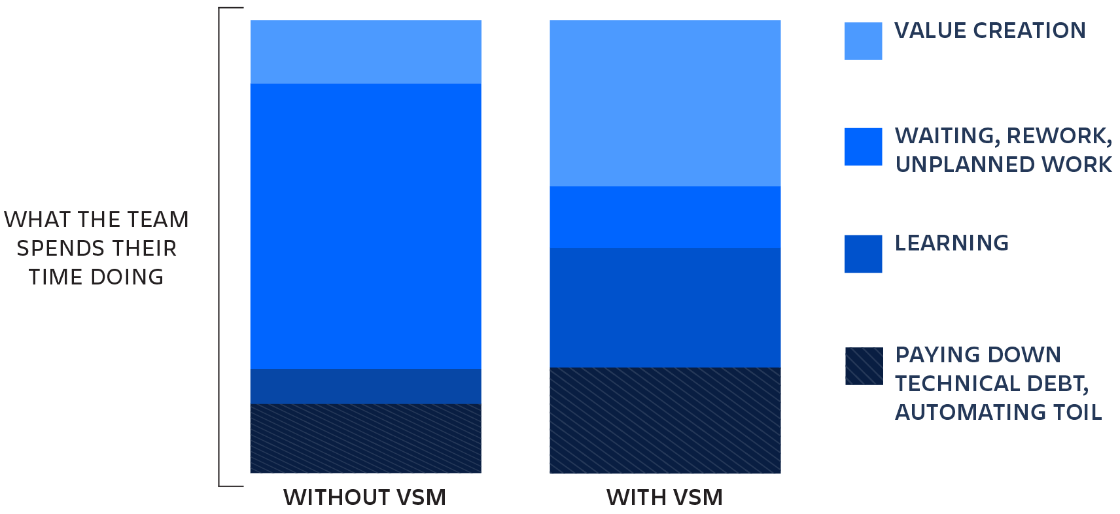
The Ideal: Minute-Long Lead Times
From Takakura, n.d.

Slide 8
Conclusion
The technology value stream is the set of processes that turn an idea into a service or feature that produces value for users
DevOps and value stream management improve the efficiency of the value chain, reducing lead times while increasing quality
Adopting DevOps practices can take lead times from months to minutes

Slide 9
References
Kim, G., Humble, j., Debois, P., & Willis, J. (2021). The DevOps Handbook, Second Edition. Portland, OR: IT Revolution.
Takakura, T. (n.d.). “What is Value Stream Management (VSM) and Why is it Important?” Atlassian. Retrieved from https://www.atlassian.com/agile/value-stream-management
Quiroz-Vázquez, C. (n.d.). “What is value stream management?” IBM. Retrieved from https://www.ibm.com/think/topics/value-stream-management

